Slide 1
Predicting Laptop Price
SmartTech Co.

Slide 2
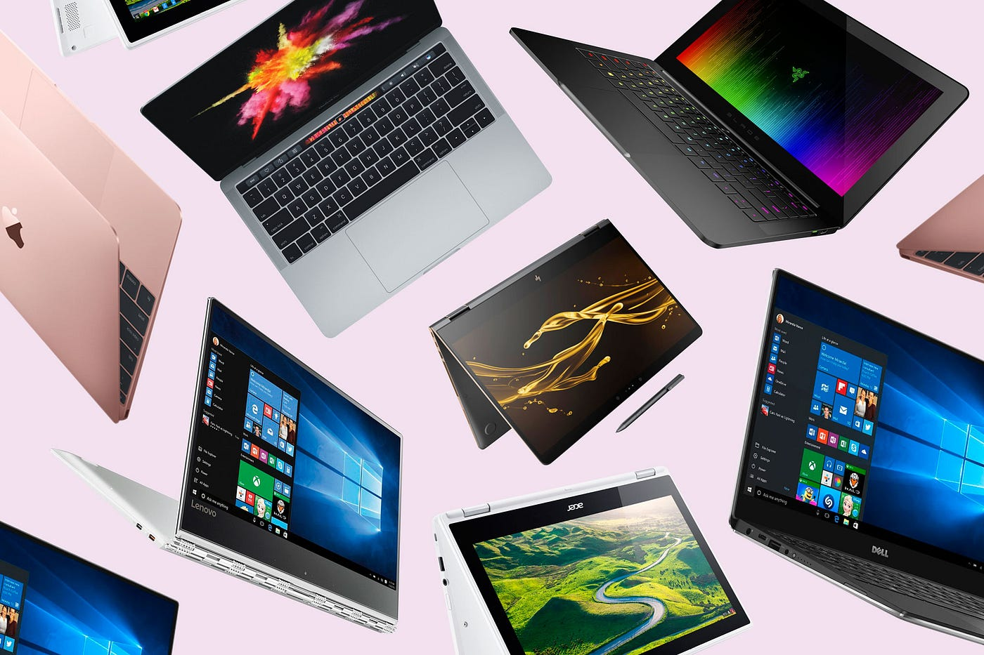
AGENDA
Introduction
Problem Statement
Solution Approach
Results
Business Impact
Implementation and Next Steps
Q&A

Slide 3

TOOLS :

Slide 4
INTRODUCTION
Project Overview:
Problem Statement: Developing a robust machine learning model to predict laptop prices accurately.
Objective: Accurate pricing, market positioning, and understanding brand influence on pricing.
Importance: Helps SmartTech Co. remain competitive by pricing their laptops accurately and strategically.

Slide 5
Business Context
Client's Objectives:
Accurate Pricing: Enhance pricing strategy based on features.
Market Positioning: Understand feature impact on prices.
Brand Influence: Assess how brand reputation affects pricing.

Slide 6
Data Overview :
Dataset Description:
Data Attributes
Key Features:
Brand: Manufacturer (e.g., Dell, HP, Apple)
Processor Type: Processor details (e.g., Intel i5, AMD Ryzen 7)
RAM: Memory size in GB
Storage: Type and capacity (e.g., 256GB SSD)
Screen Size: Size of the screen in inches
Resolution: Screen resolution (e.g., 1920x1080)
Graphics: Type of graphics card (e.g., integrated, dedicated)
Price: Laptop price in dollars (target variable)
Statistics and Summary
Basic Statistics:
Total Records: 1303 laptops
Number of Features: 8 features
Price Range: $150 - $2400
Key Statistics:
Average Price: $1129
Median RAM: 8GB
Most Common Brand: Dell
Unique Values in Categorical Features:
Brands: 19 unique brands
Processor Types: 20 unique processors
Additional Insights:
Most Common Processor: Intel i5
Most Common Storage Type: SSD

Slide 7
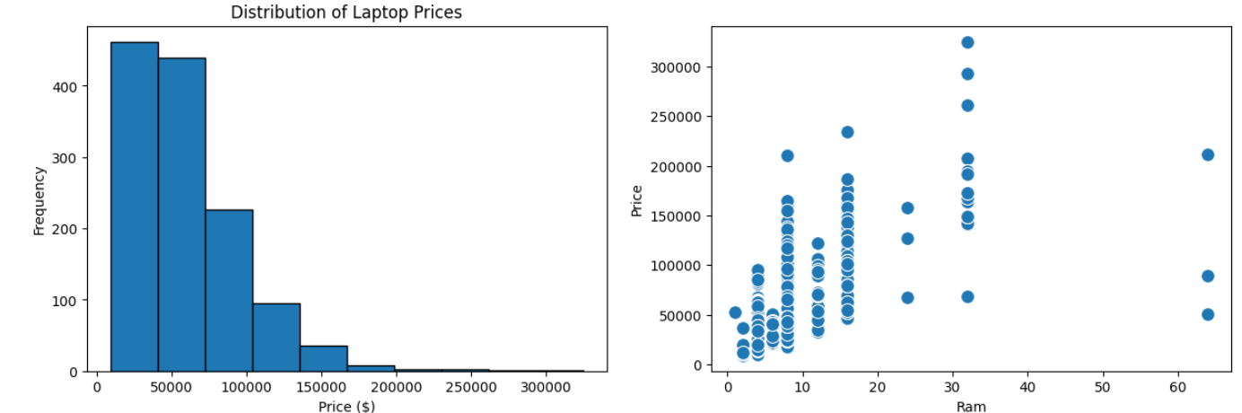
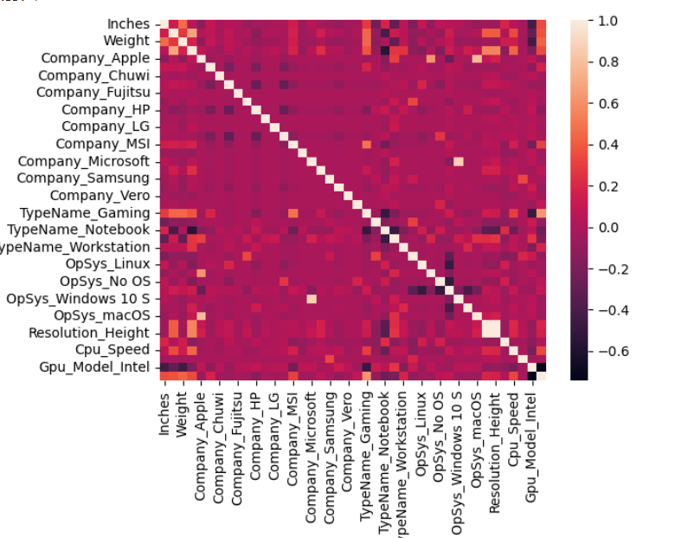
Exploratory Data Analysis :

Slide 8
Data Preprocessing :
Content:
Handling Missing Values: Most of the values are to be missing in entire row so simply drop that rows.
Encoding Categorical Variables :
Company', 'TypeName', 'Inches', 'ScreenResolution', 'Cpu', 'Ram', 'Memory', 'Gpu', 'OpSys', 'Weight

Slide 9
Feature Engineering :
New Features: ['Inches', 'Cpu', 'Ram', 'Memory', 'Gpu', 'Weight', 'Price 'Company_Apple', 'Company_Asus', 'Company_Chuwi', 'Company_Dell' 'Company_Fujitsu', 'Company_Google', 'Company_HP', 'Company_Huawei', 'Company_LG', 'Company_Lenovo', 'Company_MSI', 'Company_Mediacom','Company_Microsoft', 'Company_Razer', 'Company_Samsung' 'Company_Toshiba', 'Company_Vero', 'Company_Xiaomi', 'TypeName_Gaming', 'TypeName_Netbook', 'TypeName_Notebook', 'TypeName_Ultrabook', 'TypeName_Workstation', 'OpSys_Chrome OS', 'OpSys_Linux', 'OpSys_Mac OS X', 'OpSys_No OS', 'OpSys_Windows 10', 'OpSys_Windows 10 S', 'OpSys_Windows 7', 'OpSys_macOS', 'Resolution_Width', 'Resolution_Height', 'Memory_Numeric', 'Cpu_Speed', 'Gpu_Model_ARM', 'Gpu_Model_Intel', 'Gpu_Model_Nvidia’]
Among all features most correlation with price:
["Weight","Company_Apple", "Company_Fujitsu", "Company_Google","Company_HP",
"Company_Huawei","Company_Lenovo", "Company_MSI","Company_Mediacom","Company_Microsoft",
"Company_Vero", "TypeName_Netbook", "TypeName_Notebook","TypeName_Ultrabook",
"TypeName_Workstation", "OpSys_Windows 10 S","OpSys_macOS","Resolution_Width", "Resolution_Height","Cpu_Speed","Gpu_Model_ARM","Gpu_Model_Nvidia“]

Slide 10
Model Selection :
Linear Regression:
Random Forest :
Mean Absolute Error(MAE): $18,179.84
Root Mean Squared Error (RMSE): $25,386.51
R² Score : 0.556
Mean Absolute Error(MAE): $11,826.01
Root Mean Squared Error (RMSE): $19,308.77
R² Score : 0.743

Slide 11
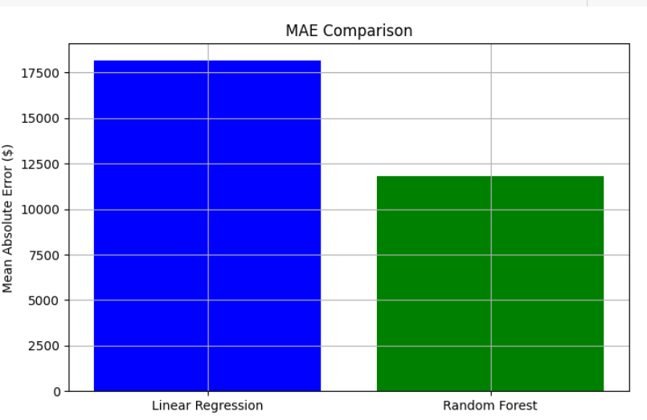
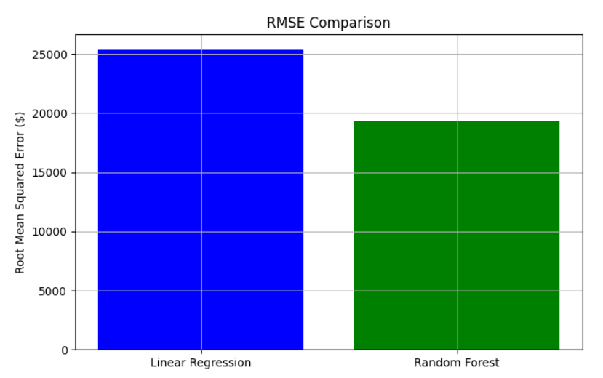
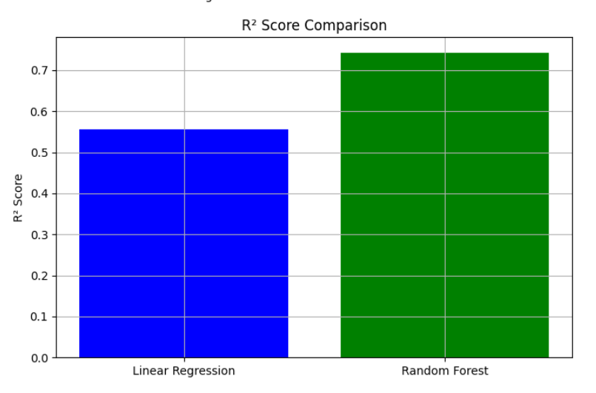
Visual Representation :
R2 score
Best Model: Random Forest, as it demonstrates superior performance with lower error metrics and a higher R² score.
Recommendation: Random Forest model for predicting laptop prices due to its improved accuracy and ability to handle complex data relationships.

Slide 12
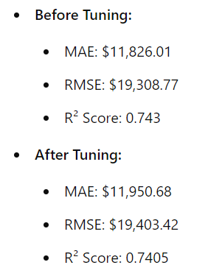
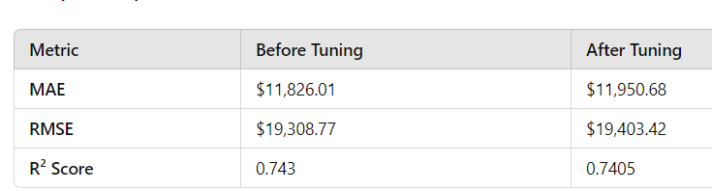
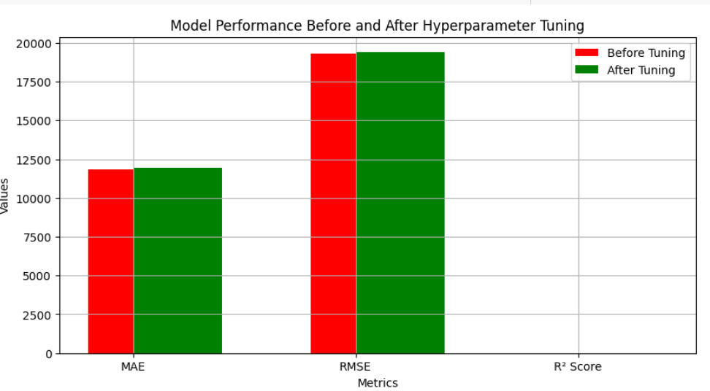
Hyper Parameter Tuning :

Slide 13
